Slide 1
Wound Analysis On different platforms & CoNCLUSION
ARP B

Slide 2
Implementation in .NET
Used K-means algorithm which stores all available cases and classifies new cases based on similarity
Speeded up Robust Features (SURF) : standard clustering based on Eucliedean distances.
Trained based on pre loaded dataset.
Creates the Support Vector Machines based on their Bag-of-Visual-Words.
Then classifies images based on SVM‘s learned previously.
Available in visual studio as packages.

Slide 3
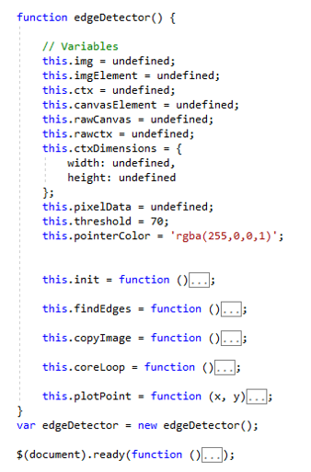
Implementation in .NET
We have used JavaScript code for the detection of wound
based on the wound edge
It uses built in functions to copy the image onto canvas.
Convert it to manageable pixels.
Then compare the pixel intensity.
Finally determine the wound edge.

Slide 4
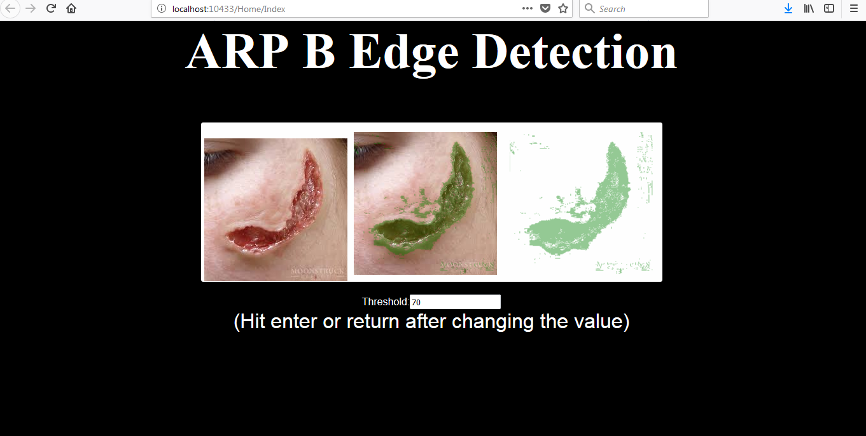
Implementation in .NET

Slide 5
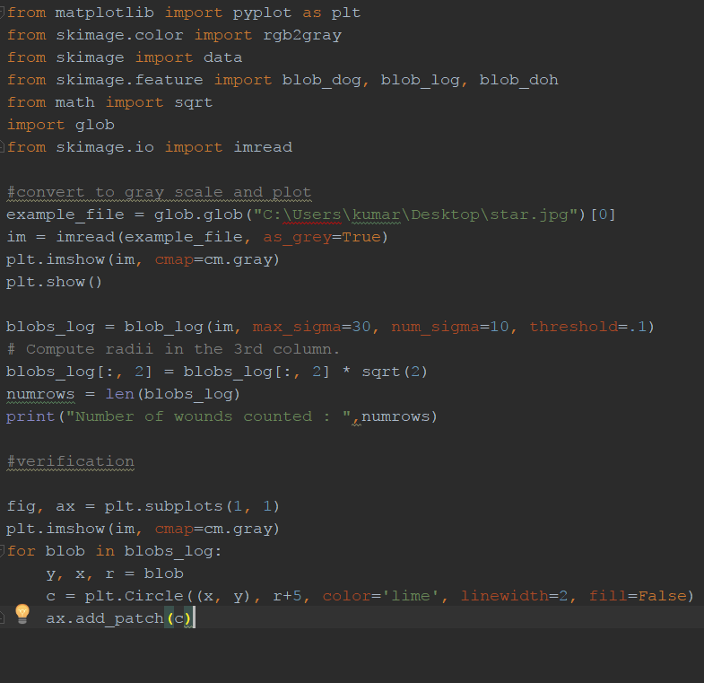
Implementation in Python
Multiple wound detection was done based on
assumption that the wound would be circular in nature.
The code takes two radii parameters and a
threshold as input and detects multiple wounds.

Slide 6
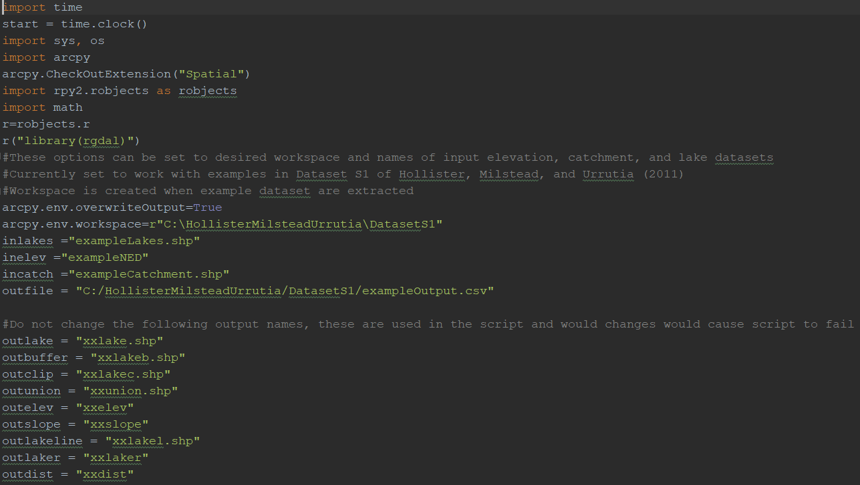
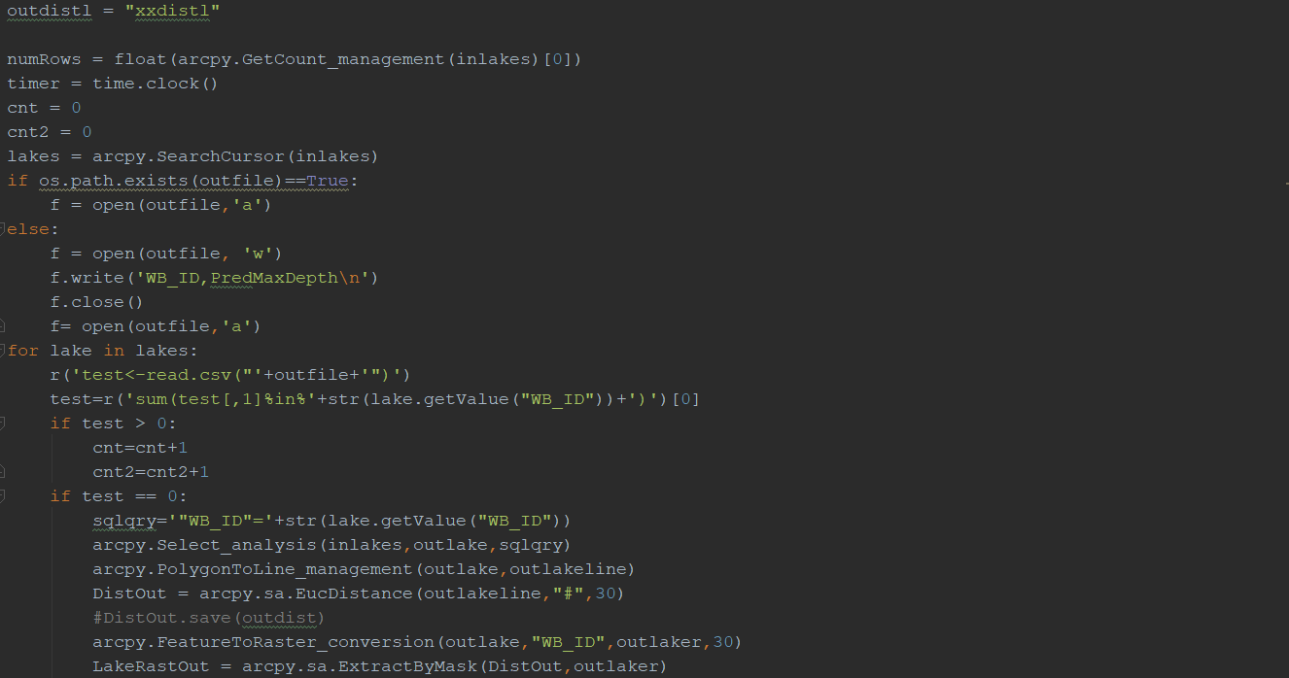
Implementation in Python
Initial idea for evaluating the wound healing process by depth calculation.
Wound healing as a direct function of change in wound depth.
The Lake Depth calculation model.
The need for a 3D photograph and angular restrictions and thresholds.

Slide 7
Implementation in MATLAB
Canny Edge detection algorithm
Strong Edge and Weak edge pixels based on Gradient and Threshold.

Slide 8
Conclusion and further scope
Our application development is limited to wound detection by edges.
It is localized to a particular set of data .
For a better decision making the wound depth calculation can be realized in .NET.
We could expand this technique for a different varieties of wounds.
Finally , our’s is just a small step towards the achieving independency from the
traditional methods getting treated.

